Slide 1
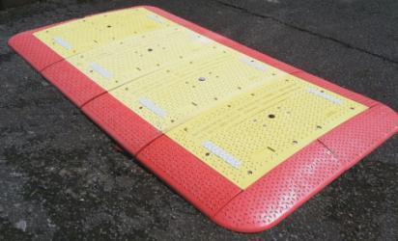
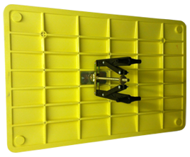
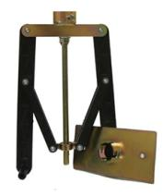
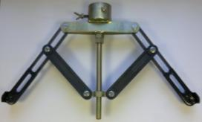
Presented by: Stephen Hilton
FUTURE OF CONSTRUCTION
Top 8 Innovations Changing the way the industry works - 2016

Slide 2
Wish List
RADLOCK - A viable option to Steel Road Plates
Lightweight Carriageway System – 2 Man Lift
No Heavy Specialist Lifting Equipment required on site
Road Plates to be rigidly fixed to the road surface
Must be made from suitable material with an appropriate skid resistant surface
Installation must not present a hazard to cyclist or motorcyclists
Must have a 44tonne Maximum Vehicle Weight capacity
Must improve time spent installing and removing from site
Capable of managing vehicles up to a speed of 30mph
To improve noise levels to an acceptable level when in use
Easily stored away when not in use
High visibility in all conditions to warn all types of traffic
Must withstand a cyclic loading for at least 2 years without failure in normal use
Road plate must be lifted in a safe manner and must have no sharp edges or protrusions as well as a safe method of carrying the road plates so not to injure hands, fingers etc.
When under loads, the road plate must not deflect more than 45mm, and permanent set must not exceed 2mm

Slide 3
When road plates can be used
Morning and evening peak periods
Evening peak to morning peak when day working
Morning peak to evening peak when night working
Weekdays when work is limited to weekends
Weekends and public holidays when work is restricted to weekdays
Specific events (e.g. parades, market days)
When no activity or delays during works
Permanently but allowing ‘frequent’ access to apparatus.

Slide 4
Factors to consider when using Road Plates
Time to install the plates
Initial installation
Removal and replacement
Traffic loading
Safety of all road users
Height of plate above the road surface
Traffic speed
Fixings
Lighting, markings, visibility and signing
Skid resistance
Noise levels and other environmental impacts
Inspection and maintenance

Slide 5
Targeting of the Utility Companies & Contractors
Lane rental Charges
Low Charge - £800 per day
High Charge - £2500 per day
Approximately 4 million of km of pipes and cables
requiring maintenance and repair
Around 4 million works per annum
Undertaken by circa 250 Utility Companies; 200 Highway Authorities and 1000 Contractors
Congestion cost as a result of Road Works in the UK is estimated at £4.3 Billion.
The Councils have been given the right to charge for lane rentals, etc direct to the Utility Companies & Contractors

Slide 6
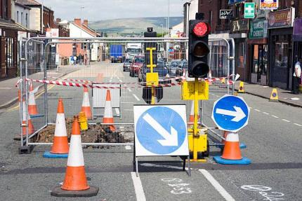
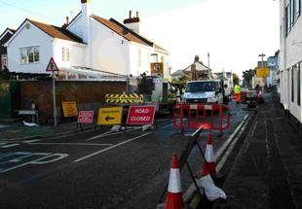
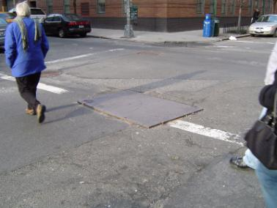

Slide 7
London Plating Workshop Developing new plating technology Adrian Wathen - Best Practice Engineer
Challenge from Mayor of London to reduce congestion caused by Road works –
Adrian Wathen of National Grid extensively worked towards reducing congestion
by utilising existing technology of modular road plates and doing so without the
necessary heavy plant that is usually required with heavy steel road plates when
delivered and fixed to the road surface.
Existing technology
Traditional Road Plates
Composite Road Plates for RDXing’s
Trenchlink System
Testing Road Crossings
Using Industry experts at Transport Research Labs to assist with the test programme,
the testers settled on 4No. Independent tests:
Test PTV Skid Resistance
40kn Central Point Load Test
Ultimate Load test
Cyclic load test based on standard axle load
Life of Road Plates
Type 1, 2 & 3 classified roads

Slide 8
London Plating Workshop
Phase 2 – Testing
Cyclical loading test
Plate layout

Slide 9
London Plating Workshop
Phase 2 – Next Steps
Following the successful outcome of the test programme National Grid are;
Proceeding with a number of field trials of the tested products to determine user acceptance in the working environment
Pursuing hire agreements via our Global Procurement Department
Developing a new internal specification for road plating based on the outcomes of the test programme

Slide 10
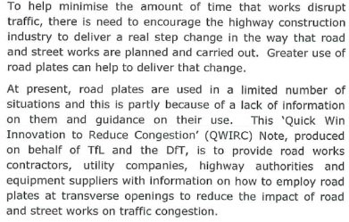
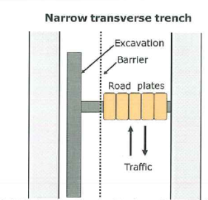
The brief - Quick win in reducing congestion QWIRC3

Slide 11
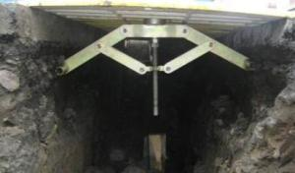
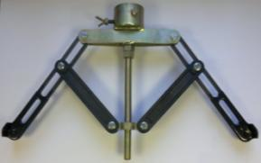
The Brief – Quick win in reducing congestion QWIRC3
Transport for London (TfL) encourages the use of plates to reduce congestion in the
capital and other areas of the U.K. They have recently invested over £1million to find a
solution for covering excavations, through trials at TRL.
(please see Test Results and Approvals – QWIRC3)
When tested road plates needed to be capable of safely supporting a load of 5.75tonnes
single wheel load.
Any locking mechanism would also need to withstand these loads and directional force in
order to maintain a good contact with the road surface at all times. The Radlock Series
15 can withstands this load, and after 65,000 passes there were no signs of any fatigue on
the Radlock Locking mechanism.

Slide 12
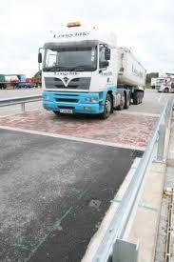
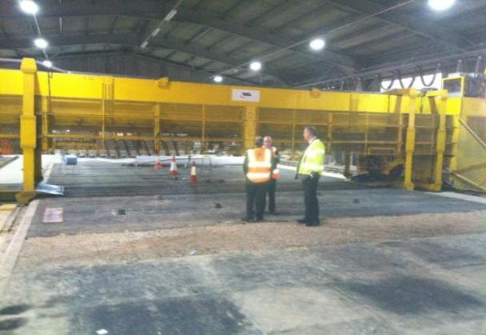
TRL Product tested on Transport Reserach Laboratory test rig and track
The ONLY composite carriageway system approved for use by TfL for road crossings, linear trenches and core & vac uses across the TLRN.
Transport for London have granted the Radlock Carriageway System approval for use across the TLRN.

Slide 13
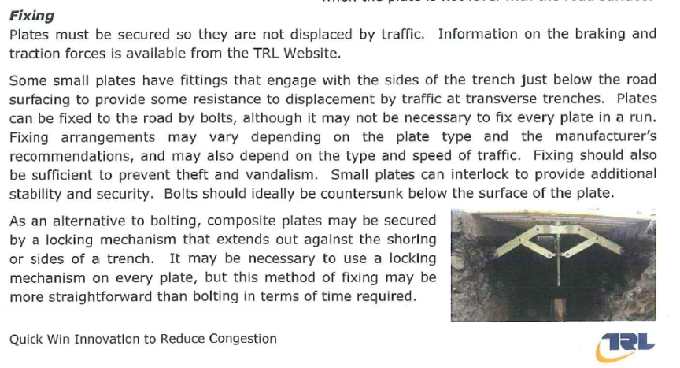
The Brief – Quick win in reducing congestion QWIRC3 Safety at Street Works and Road Works – A Code of Practice

Slide 14
Safety at Street Works and Road Works A Code of Practice

Slide 15
Safety at Street Works and Road Works A Code of Practice

Slide 16
Safety at Street Works and Road Works A Code of Practice

Slide 17
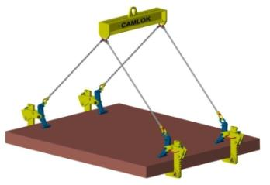
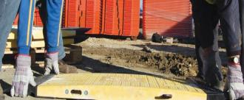
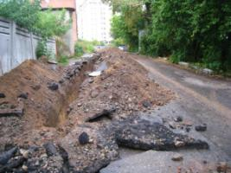
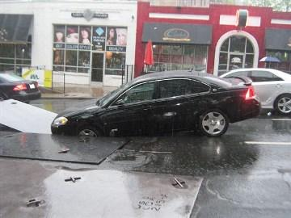
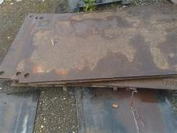

Slide 18
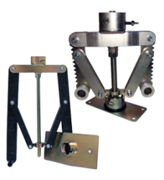
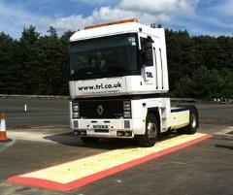
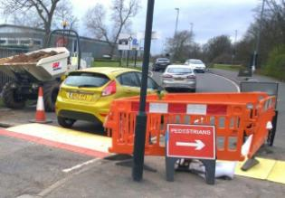
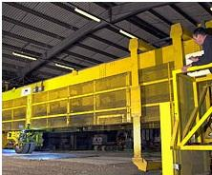

Slide 19
How can we help the Utility Companies & Contractors?
Reducing of carriageway occupation at peak period – minimises lane rental charges but may increase labour cost
Plating Techniques to help in handing carriageway back during peak hours
Allows Site Operatives to quickly engage on site rather than when reinstatement has been used and the trench to be re-excavated – allows shorter work duration
Quicker, Safer method of plating over trenches and open excavations
7m RDXing = 15minutes / 2 Man Lift
Less Spoil to be removed from site – no expensive cut backs and extra over ‘black top’ reinstatement
Less Reinstatement Costs, Cut back costs
No use for Hiab or Heavy Lifting machinery to lift in to place and remove off site
Reduction of works duration
Labour force more productive – less time to plate open trenches, therefore allowing more ‘working’ time
Less disruption to travelling public
Peak periods allowed for and trenches secure
Pedestrians allowed to walk across a secured footway board
Safety at Street Works and Road Works – A Code of Practice

Slide 20
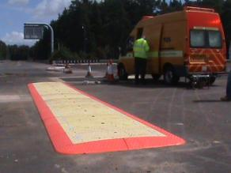
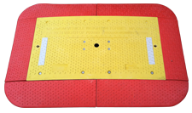
How can we help the Utility Companies & Contractors?
The Only Composite Carriageway System tested and approved for use on the Transport London Road Network (TLRN) for Linear, Core & Vac and Transverse trenches
65000 passes of up to 5.5tonnes – Severe testing (TRL)
Pavement Testing facility on Super Single Wheel Axle
Lightweight Carriageway System
2 Man lift (manhole key operation)
Road Plate Weight 46kg (Inner Board) / 48.7kg (End Board)
Delivery to Site by Pick Up or similar
(whole system 7.2m = 655kg)
Theft issue reduced if not eradicated
no sell on value / cannot remove from trench once Radlock’d
Rigorously Tested and Approved by Transport for London
Department for Transport
44 tonne Maximum Vehicle Weight capacity
point load of 23.5t achieved

Slide 21
How can we help the Utility Companies & Contractors?
Fixed in place without drilling into the Carriageway
Reduces Reinstatement costs
Skid Resistance for all traffic and pedestrians
Capable of spanning a trench width of 700mm
Decreases unacceptable noise levels when driven over –Public nuisance
Reduces Insurance claims for accidents caused by movement of boards
Complies with National Grid T/SP/E/42 specification
TRL have given this product a 3 year minimum lifespan
(based on Type 1 Roads, and it is anticipated that much of their use will also be on Type 3 / 4 roads thus extending that period (R W Jordan & C Sadat-Shafaee – TRL)

Slide 22
Radlock Introduction
Although current methods are used across the Industry, these can represent:-
Hazard to both workers and members of the public
Removal by vandals especially footpath boards.
Cost of replacing footpath boards or steel road plates if they are stolen
With steel road plates – cost of repeated anti skid coating renewal
No Heavy Lifting equipment required – Simple 2 Man Lift using Manhole Keys.
Securing the boards with nails or screws could end up with:
expensive cutback on reinstatements
replacement boards
injuries to members of the public
This method reduces plant, labour and material costs all in one system
PLEASE SEE COST ANALYSIS ON RADLOCK TESTS & APPROVALS PAGE

Slide 23
Radlock Carriageway & Footpath System
Almost 33,000 people get hurt each year walking on the British roads with Falls on Public Footpaths
Pedestrian accidents can be avoided. It goes without
saying that most of the pedestrian accidents taking place
all over the world are caused because of negligence.
The injuries caused by faulty footpaths could range from
minor bruises to near fatal ones where a person may possibly
even lose their life after falling in a deep, open excavation.
Injuries caused due to the pavement fall:-
Foot injuries
Ankle injuries
Knee Injuries
Back and Neck injuries

Slide 24
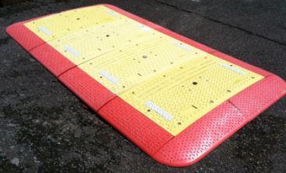
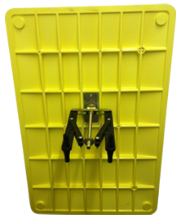
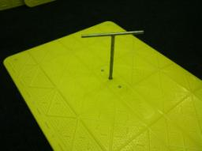
Radlock System
Advantages of Radlock:
Robust construction from steel /
coated steel legs and Norel 6 grade
plastic (Series 12) make it durable and hard
wearing
Quick & Easy to use -
simple lock and key mechanism using a
standard ‘T’ bar or 24mm Socket with Speed brace
carried by the majority of utility contractors
Can be used in any ground type.

Slide 25
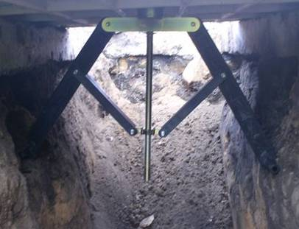
Radlock System
Advantages of Radlock:
Secure - Once in place it cannot be
removed without the key
Versatile design for use in excavations
of 200/250mm - 1050mm
(bespoke designs available)
Detaches from board to allow easy
stacking when not in use.
PATENTED DESIGN

Slide 26
Radlock Test Results & Approvals (click on each heading to view document)
Transport for London / Transport Research Laboratory (SHORT REPORT)
Department for Transport – Traffic Advisory Leaflet
Using road plates at road works
Cost Analysis
Radlock Composite Carriageway System –v- Traditional Steel Road Plates
QWIRC3 – Use of Road Plates
QWIRC3 – Radlock use of TRL’s Pavement Test Facility
Test Report on Skid Resistance Levels
National Grid – Development of New Plating Technology
Produced by Adrian Wathen
Richard Jordan (TRL) – Road Plates Presentation
National Grid – T/SP/E/42 Specification
Instruction Manuals
Carriageway System
Footpath System

Slide 27
Approvals & Customers within the U.K.

Slide 28
STEPHEN HILTON
stephen@radlock.co.uk
07507-998825

